Slide 1
EER model

Slide 2
Why Enhanced ER diagrams?
Complexity of the data is increasing so it becomes more and more difficult to use the traditional ER model for database modeling.
To reduce this complexity of modeling we have to make improvements or enhancements to the existing ER model to make it able to handle the complex application in a better way.

Slide 3
What we can represent?
Sub Class and Super Class
Specialization and Generalization

Slide 4
Supertype or Super class
A supertype is a higher-level, generalized entity that has common attributes that can be inherited by lower-level entities known as subtypes.
It represents a generic entity type that captures the shared characteristics of its subtypes.

Slide 5
Subtype or subclass
Subtype
This term is more commonly used in the context of entity-relationship modeling.
A subtype in an EER diagram is a subset of another entity (known as the super type) that shares common features with the super type but also has additional features or attributes that distinguish it from other subtypes.
Subtypes are used to model an inheritance hierarchy where subtypes inherit attributes and relationships of their super type.

Slide 6
Characteristics
Shared Attributes: Attributes that are common across various subtypes are placed in the supertype to avoid redundancy. For example, if 'Employee' is a supertype, it might include attributes like EmployeeID, Name, and Address, which are common to all kinds of employees.
Inheritance: Subtypes inherit the common attributes and behaviors (like relationships and constraints) from their supertype. This inheritance mechanism promotes data integrity and reduces redundancy.

Slide 7
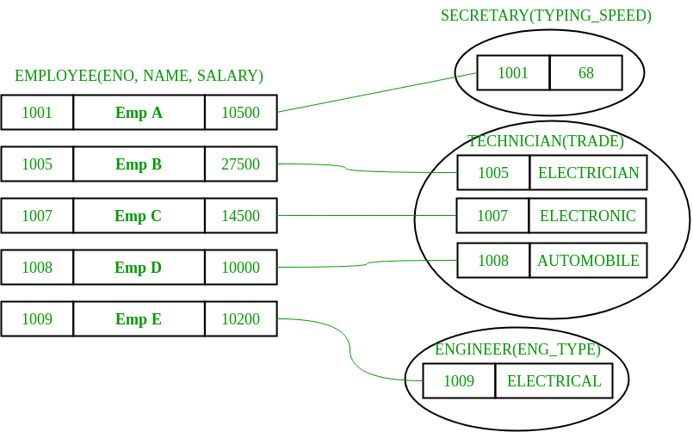
Example

Slide 8
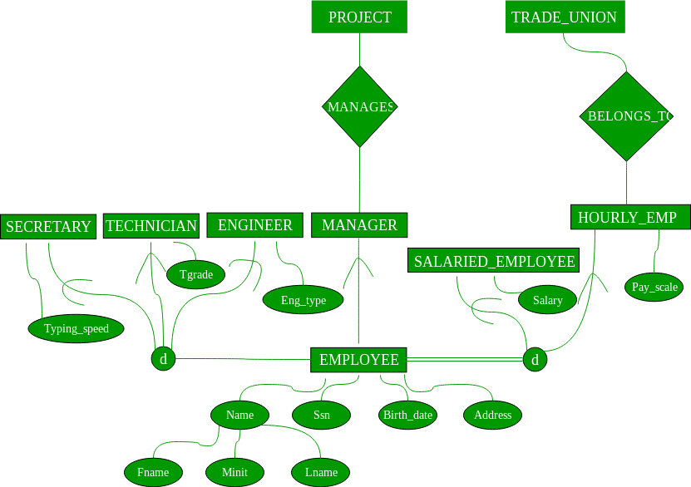

Slide 9
Generalization and Specialization:
Generalization is the process of identifying common attributes and relationships between entities and creating a supertype based on these common features.
Specialization is the process of identifying unique attributes and relationships between entities and creating subtypes based on these unique features.

Slide 10
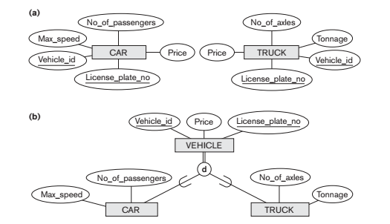

Slide 11
note
Notice that the generalization process can be viewed as being functionally the inverse of the specialization process. In the above Figure we can view {CAR, TRUCK} as a specialization of VEHICLE, rather than viewing VEHICLE as a generalization of CAR and TRUCK

Slide 12
1.The database keeps track of three types of persons: employees, alumni, and students. A person can belong to one, two, or all three of these types. Each person has a name, SSN, sex, address, and birth date.
2. Every employee has a salary, and there are three types of employees: faculty, staff, and student assistants. Each employee belongs to exactly one of these types. For each alumnus, a record of the degree or degrees that he or she earned at the university is kept, including the name of the degree, the year granted, and the major department. Each student has a major department.
3. Each faculty has a rank, whereas each staff member has a staff position. Student assistants are classified further as either research assistants or teaching assistants, and the percent of time that they work is recorded in the database. Research assistants have their research project stored, whereas teaching assistants have the current course they work on.
4. Students are further classified as either graduate or undergraduate, with the specific attributes degree program (M.S., Ph.D., M.B.A., and so on) for graduate students and class (freshman, sophomore, and so on) for undergraduates.

Slide 13
